Slide 1
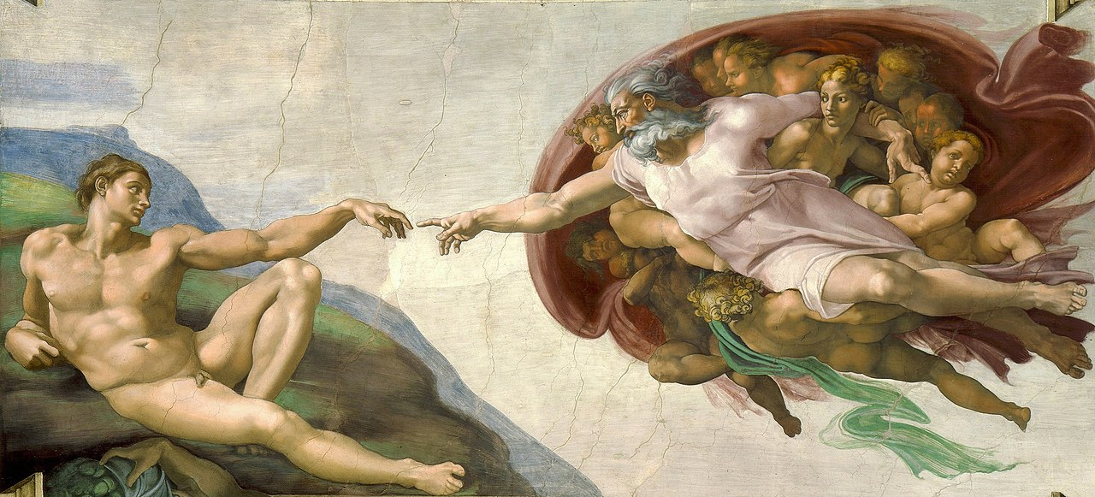
Creation & Evolution: A Catholic Conception of Man
The Creation of Adam
Fresco painting by Michelangelo
c. 1508–1512

Slide 2
St. Thomas Aquinas Prayer before Study
Creator of all things, true Source of light and wisdom, lofty origin of all being, graciously let a ray of Your brilliance penetrate into the darkness of my understanding and take from me the double darkness in which I have been born, an obscurity of both sin and ignorance. Give me a sharp sense of understanding, a retentive memory, and the ability to grasp things correctly and fundamentally. Grant me the talent of being exact in my explanations, and the ability to express myself with thoroughness and charm. Point out the beginning, direct the progress, and help in completion; through Christ our Lord. Amen.

Slide 3
Key Questions
SCRIPTURE: What Truths are presented in the first chapters of Genesis that explain how we are to understand the communion between God as Creator and Man as His creation?
CHURCH TEACHING: What does the Church say about creation in the first chapters of Genesis, which helps us understand what science has proposed and demonstrated in evolution?
SCIENTIFIC METHOD: What is the relationship between science and faith to help us understand God and His creation?

Slide 4
“Popcorn” Reading Genesis 1:24-31

Slide 5
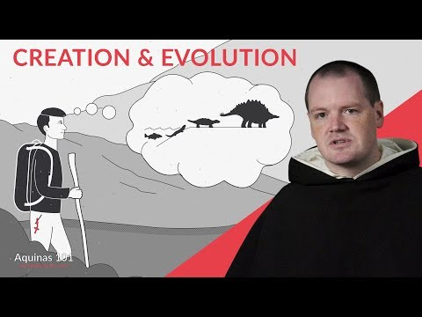
Are Creation and Evolution compatible?

Slide 6
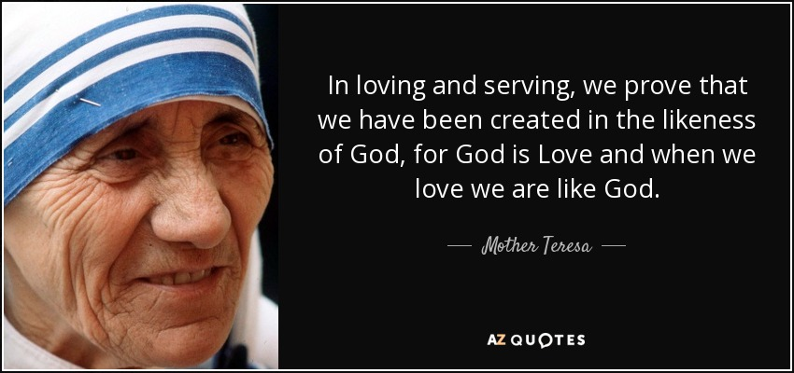
“Image and Likeness” of God
1. God is our Father.
We are directly related to God, our Creator, who loves us as a father loves his children.
2. We have a rational soul.
We are like God in that we have a rational soul and the capacity to know and love God.
https://www.azquotes.com/quote/1345100

Slide 7
“Image and Likeness” of God
3. Human life possesses great sacredness.
God’s breath animated our bodies with a soul.
4. Man is made for communion with God.
This is meant to be Man’s permanent state.
https://www.azquotes.com/quote/1345100

Slide 8
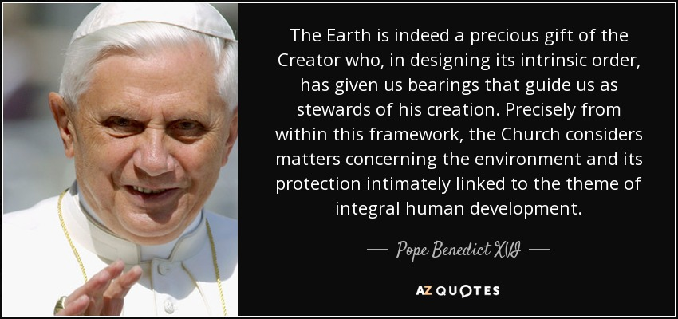
God’s Two Divine Commands to Man
“be fertile and multiply; fill the earth”
“subdue it” of God’s creation; dominion and stewardship
https://www.azquotes.com/quote/685947

Slide 9
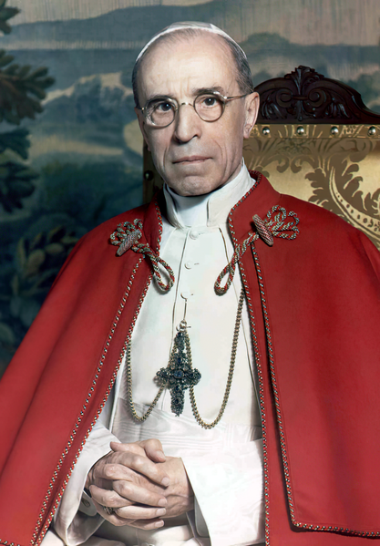
Church Teaching of Creation Narrative & Evolution
To answer this question, we are turning to Humani Generis, a Papal encyclical of Pius XII (1950)
What is Humani Generis: Humani Generis is a papal encyclical that is "concerning some false opinions threatening to undermine the foundations of Catholic Doctrine". This document is concerned with the rising Nouvelle Théologie which will go on to have great influence at the Second Vatican Council starting during the following decade. The document itself deals directly with evolution and outlines dei Fide positions on the subject (wikipedia).
File:Pius XII with tabard, by Michael Pitcairn, 1951.png

Slide 10
Humani Generis, a Papal encyclical of Pius XII (1950)
In Groups, read and summarize
§36 and §37, as well as the warning found in §38.

Slide 11
Humani Generis, a Papal encyclical of Pius XII (1950)
§36: We may speculate on the origins of man’s human body as coming from “pre-existent and living matter” but must firmly hold that man’s soul comes directly from God.
§37: We must hold that the human race as it stands today, are the descendants of first parents whom God had raised to a higher life through the inbreathing of the spiritual soul. These first parents freely rejected God’s commands to commit original sin. As their descendants, we inherit original sin.
§38: Warns of a liberal reading of Genesis as anything other than a history that conveys Truths about God and Man.
File:Pius XII with tabard, by Michael Pitcairn, 1951.png

Slide 12
Humani Generis, a Papal encyclical of Pius XII (1950)
The document then clearly states that “the Teaching Authority of the Church does not forbid that, in conformity with the present state of human sciences and sacred theology, research and discussions, on the part of men experienced in both fields, take place with regard to the doctrine of evolution” so long as we hold the Truths outlined above (HG, 36).
File:Pius XII with tabard, by Michael Pitcairn, 1951.png

Slide 13
Assessment
TOPIC QUESTION: What is the relationship between science and faith to help us understand God and His creation?
DIRECTIONS:
Watch the following video on your iPad. and answer the questions on Google Classroom.
The Scientific Method: Common Objections to Faith with Prof. Karin Öberg (Aquinas 101) from The Thomistic Institute https://www.youtube.com/watch?v=JAkj5P6IHUQ
Answer the following questions on Google Classroom.
What are the 4 kinds of objections to faith in God shared by Prof. Karin Oberg?
How does the teaching of the Catholic Church answer the 2nd objection?
Name 10 Catholic scientists mentioned in the video.
What is the relationship between faith and science to help us understand God and His creation?

Slide 14
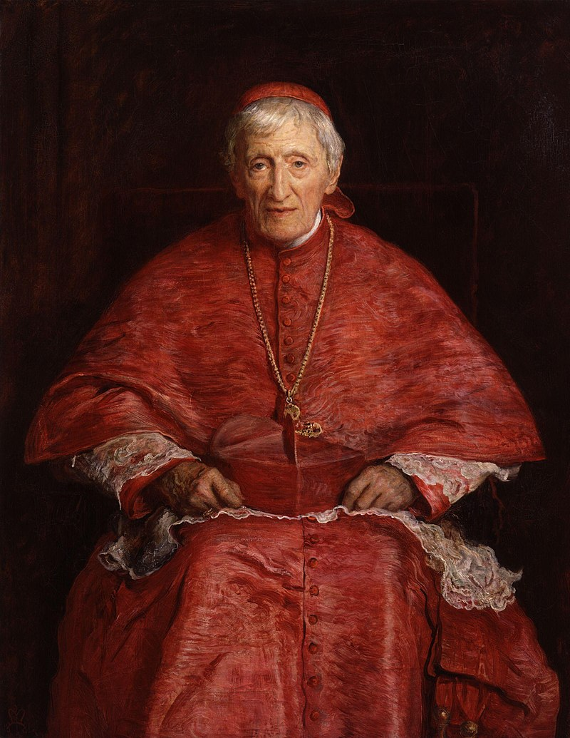
SUMMARY & ANALYSIS
DIRECTIONS:
Read and reflect the following article by Berta M. Moritz on St. John Henry Newman.
SAINT JOHN HENRY NEWMAN: A CO-PATRON FOR SCIENTISTS? From Society of Catholic Scientists
https://www.catholicscientists.org/idea/saint-john-henry-newman-a-co-patron-for-scientists
“Truth cannot be contrary to truth.”
“I believe in design because I believe in God; not in a God because I see design.”
“Evolution is not inconsistent with divine design - It is accidental to us, not to God.”
File:John Henry Newman by Sir John Everett Millais, 1st Bt.jpg
Created: 1881

Slide 15
CONCLUSION
Pope Emeritus Benedict XVI (Homily at the Mass for the Inauguration of the Pontificate, 24 April 2005)
“[O]nly where God is seen does life truly begin. Only when we meet the living God in Christ do we know what life is. We are not some casual and meaningless product of evolution. Each of us is the result of a thought of God. Each of us is willed, each of us is loved, each of us is necessary.”

